Slide 1
Lecture 6
Threat Intelligence and Threat Hunting

Slide 2
6. Threat Intelligence and Threat Hunting
6.1 Role of threat intelligence in SOC operations
6.2 Sources of Threat Intelligence Data
6.3 Threat hunting methodologies and techniques
6.4 Incorporating threat intelligence into incident response

Slide 3
Objectives
After studying this chapter, you should be able to:
Understand the importance of threat intelligence in improving proactive threat detection and response, as well as its function in SOC operations.
Identify the different sources of threat intelligence information, such as vendor reports, internal telemetry, open-source feeds, and dark web monitoring.
Apply threat hunting methodologies and techniques such as behavioral analytics, anomaly detection, and signature-based detection to proactively seek out potential threats within the network environment.
To reduce the impact of security incidents on organizational assets and to improve response efforts, effectively incorporate threat intelligence into incident response processes.
To keep ahead of developing cyber threats, continuously improve your threat intelligence methods and processes based on insights from threat hunting efforts and incident response results.

Slide 4
6. Threat Intelligence and Threat Hunting
6.1 Role of threat intelligence in SOC operations

Slide 5
What is Threat intelligence?
Threat intelligence—also called "cyberthreat intelligence" (CTI)
Threat intelligence is data that is collected, processed, and analyzed to understand a threat actor’s motives, targets, and attack behaviors.
Threat intelligence enables us to make faster, more informed, data-backed security decisions and change their behavior from reactive to proactive in the fight against threat actors.
Threat intelligence helps security teams be more proactive, enabling them to take effective, data-driven actions to prevent cyberattacks before they occur. It can also help an organization detect and respond to attacks in progress faster.

Slide 6
Why is Threat Intelligence Important?
Threat intelligence is crucial for organizations due to its role in predictive, preventative, detection, and responsive measures:
1.Predictive Measures: It allows organizations to anticipate future threats, enabling proactive planning and prevention of potential attacks.
2.Preventative Measures: By providing insights into emerging threats, threat intelligence helps organizations fortify their defenses, thereby reducing the likelihood of successful cyber attacks such as malware infiltration.
3. Detection Measures: Threat intelligence aids in the identification of both ongoing and latent threats within networks, including understanding the tactics, techniques, and procedures employed by cyber criminals during reconnaissance or active operations.
4. Responsive Measures: In the event of a security incident, threat intelligence informs an effective response strategy, potentially minimizing the impact and extent of the breach. For instance, indicators of compromise (IoCs) discovered in an organization's environment guide security teams on how to respond to cyber attacks effectively.

Slide 7
Roll of Threat intelligence in SOC operations.
Exploring Threat Intelligence within a Security Operations Center (SOC) and its role in enhancing an organization's overall security stance.
Threat Intelligence involves gathering, examining, and sharing data about existing and potential security risks that may affect an organization.
It is a crucial element of contemporary cybersecurity and plays a pivotal role in protecting an organization's assets and data.

Slide 8
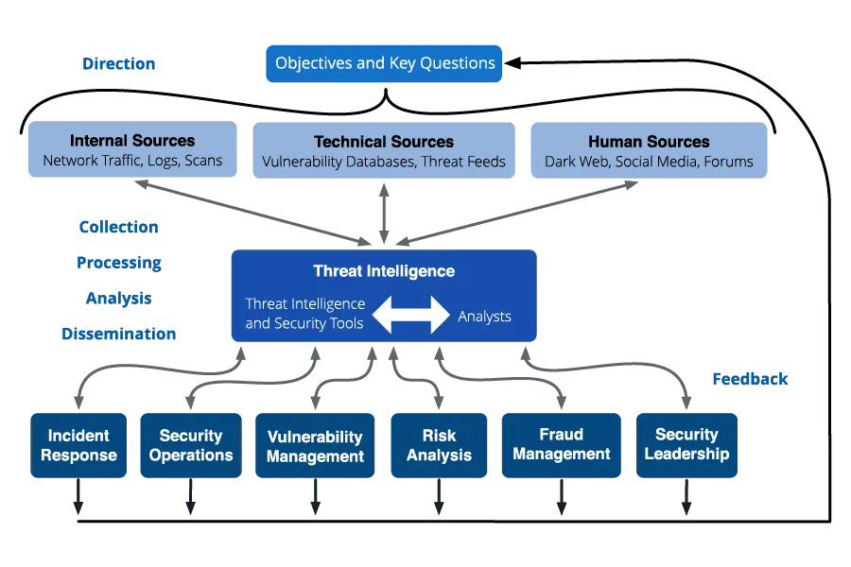

Slide 9
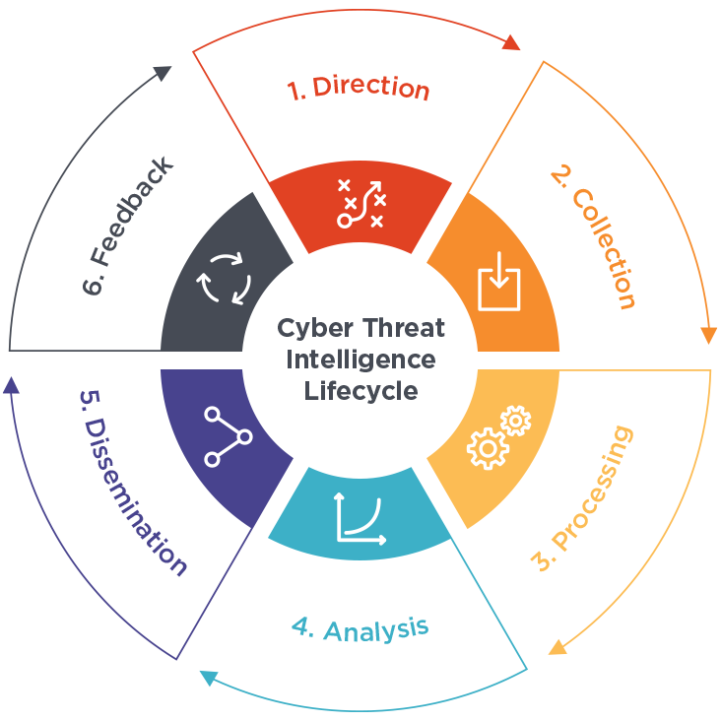
Threat intelligence lifecycle
1. Planning and direction: Define goals, identify threats, allocate resources.
2. Collection: Gather data from various sources.
3. Processing: Organize and analyze collected data.
4. Analysis: Evaluate data to identify threats and potential impact.
5. Dissemination: Share relevant information with stakeholders.
6. Feedback: Assess usefulness of information, improve processes iteratively.

Slide 10
How Threat Intelligence is Used in a SOC?
Threat Detection :
-Identifying new and emerging threats, including malware and phishing attempts.
- Recognizing known threats that are still active, allowing for early prevention.
2. Vulnerability Management :
- Using threat intelligence to pinpoint new vulnerabilities in systems and networks.
- Prioritizing vulnerabilities based on risk level to facilitate timely patching or mitigation.
3. Incident Response:
- Leveraging threat intelligence to enhance incident response strategies.
- Gaining insights into cybercriminal tactics, techniques, and procedures to develop effective response plans.
4. Security Automation:
- Integrating threat intelligence with automation tools for streamlined incident response and vulnerability management.
- Enabling automated actions such as patching, incident escalation, and threat containment for quicker and more efficient responses.
-.

Slide 11
Challenges in Implementing Threat Intelligence in a SOC:
1.Investment in technology and personnel: Organizations need to invest in the right technology and personnel for effective threat intelligence implementation, including hardware, software, and skilled employees.
2.Processes and procedures: Establishing robust processes and procedures for analyzing, disseminating, and responding to threat intelligence is crucial for its effective utilization within a SOC.
3.Volume of data: The sheer volume of data generated by threat intelligence can overwhelm a SOC, requiring adequate resources and tools for efficient analysis and dissemination.
4.Quality of data: Ensuring the quality of threat intelligence data is essential, as not all sources are reliable. Organizations must verify authenticity, credibility, relevance, and timeliness of the information.
5.Integration with existing systems: Integrating threat intelligence seamlessly into existing systems and processes, such as incident response and security operations, requires thorough understanding and planning.
6.Maintenance and updating: Threat intelligence is dynamic and requires continuous maintenance and updating to stay relevant. This involves monitoring new threats, updating existing information, and providing ongoing training to SOC personnel.
-.

Slide 12
Merits and Demerits of Threat Intelligence in a SOC
Merits (Advantages) | Demerits (Disadvantages)
Enhanced Security Awareness: Organizations gain insights into potential threats. | Overwhelming Volume: Sorting through vast amounts of data can be challenging.
Proactive Threat Detection: Early identification and mitigation of potential threats. | False Positives: Inaccurate alerts can waste resources.
Informed Decision Making: Better security posture decisions based on data. | Cost: Implementing and maintaining can be expensive.
Incident Response Improvement: Streamlined response with relevant context. | Integration Challenges: Integration with existing systems can be complex.
Competitive Advantage: Stay ahead in security and maintain trust. | Privacy Concerns: Raises questions about data privacy.

Slide 13
Incorporating threat intelligence into incident response.
Threat Intelligence plays an important role in incident response since it improves an organization's capacity to identify, reduce and recover back from cybersecurity incidents. It offers essential background knowledge and perspectives into the future.
  Early Detection: Threat information helps in identifying possible threats and weaknesses before they develop, enabling proactive monitoring.
  Rapid Identification: Analysts may promptly identify familiar attack patterns and signs, assisting in the initial phases of an incident.
  Contextual Insight: Intelligence enhances incident data by providing details on threat actors, tactics, approaches, and motivations, which helps in conducting precise event evaluations.
  Prioritization: Incident prioritization assists responders in ranking situations according to severity, possible impact, and organizational importance.

Slide 14
Incorporating threat intelligence into incident response
Customized Response: Threat intelligence enables the development of tailored plans to address specific threats, enhancing containment and mitigation actions.
Threat hunting: It involves analysts actively searching for indicators of potential threats that have not been noticed at this point utilizing threat intelligence information.
Attribution: Intelligence helps identify the source of assaults by recognized danger individuals or organizations, guiding reaction strategies and possible legal measures.
Mitigation Recommendations: It offers practical suggestions for addressing and protecting against future threats.
Intelligence sharing: It improves crisis response capability.
Continuous improvement: is archived by using threat intelligence to analyze incidents and enhance security policies for better protection against future attacks.

Slide 15
6. Threat Intelligence and Threat Hunting
6.2 Sources of Threat Intelligence Data

Slide 16
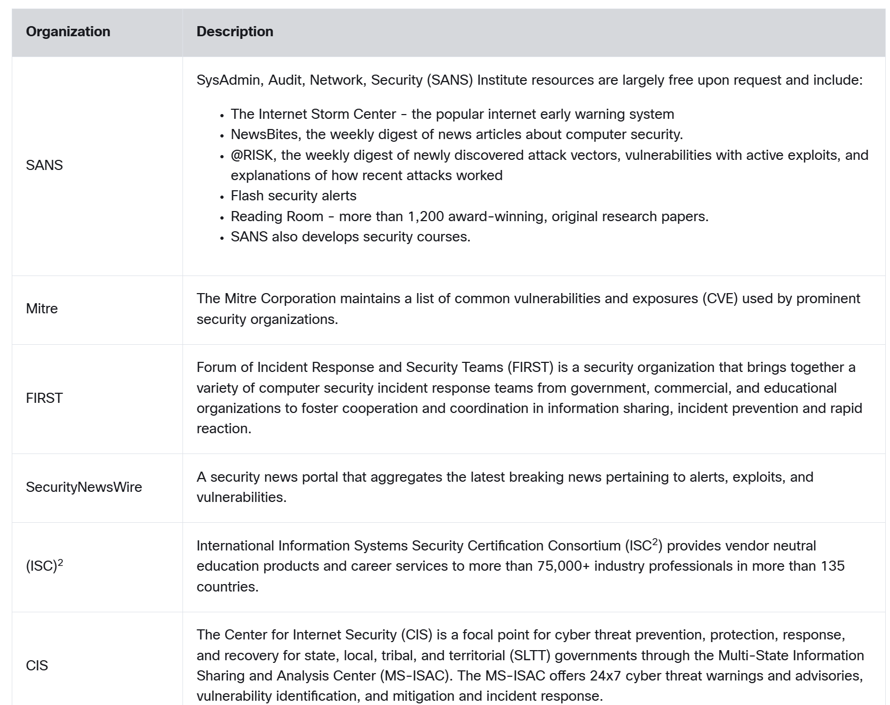
Network Intelligence Communities

Slide 17
Cisco Cybersecurity Reports
  Resources to help security professionals stay abreast of the latest threats are the Cisco Annual Cybersecurity Report and the Mid-Year Cybersecurity Report. These reports provide an update on the state of security preparedness, expert analysis of top vulnerabilities, factors behind the explosion of attacks using adware, spam, and more.
  Cybersecurity analysts should subscribe to and read these reports to learn how threat actors are targeting their networks, and what can be done to mitigate these attacks.
  Search the internet to locate and download Cisco Cybersecurity Reports from the Cisco website.
Security Blogs and Podcasts
  Another method for keeping up-to-date on the latest threats is to read blogs and listen to podcasts. Blogs and podcasts also provide advice, research, and recommended mitigation techniques.
  There are several security blogs and podcasts available that a cybersecurity analyst should follow to learn about the latest threats, vulnerabilities, and exploits.
  Cisco provides blogs on security-related topics from a number of industry experts and from the Cisco Talos Group. Search for Cisco security blogs to locate them. You can also subscribe to receive notifications of new blogs by email. Cisco Talos also offers a series of over 80 podcasts that can be played from the internet or downloaded to your device of choice.

Slide 18
Threat Intelligence Services
Threat intelligence services allow the exchange of threat information such as vulnerabilities, indicators of compromise (IOC), and mitigation techniques. This information is not only shared with personnel, but also with security systems. As threats emerge, threat intelligence services create and distribute firewall rules and IOCs to the devices that have subscribed to the service.
Talos is one of the largest commercial threat intelligence teams in the world, and is comprised of world-class researchers, analysts and engineers. The goal of Talos is to help protect enterprise users, data, and infrastructure from active adversaries. The Talos team collects information about active, existing, and emerging threats. Talos then provides comprehensive protection against these attacks and malware to its subscribers.
  Cisco Security products can use Talos threat intelligence in real time to provide fast and effective security solutions. Cisco Talos also provides free software, services, resources, and data. Talos maintains the security incident detection rule sets for the Snort.org, ClamAV, and SpamCop network security tools.

Slide 19
FireEye
  FireEye is another security company that offers services to help enterprises secure their networks. FireEye uses a three-pronged approach combining security intelligence, security expertise, and technology.
  FireEye offers SIEM and SOAR with the Helix Security Platform, which uses behavioral analysis and advanced threat detection and is supported by the FireEye Mandiant worldwide threat intelligence network. Helix is cloud-hosted security operations platform that combines diverse security tools and threat intelligence into a single platform.
  The FireEye Security System blocks attacks across web and email threat vectors, and latent malware that resides on file shares. It can block advanced malware that easily bypasses traditional signature-based defenses and compromises the majority of enterprise networks. It addresses all stages of an attack lifecycle with a signature-less engine utilizing stateful attack analysis to detect zero-day threats.
Automated Indicator Sharing
  The U.S. Department of Homeland Security (DHS) offers a free service called Automated Indicator Sharing (AIS). AIS enables the real-time exchange of cyber threat indicators (e.g., malicious IP addresses, the sender address of a phishing email, etc.) between the U.S. Federal Government and the private sector.
  AIS creates an ecosystem where, as soon as a threat is recognized, it is immediately shared with the community to help them protect their networks from that particular threat.
  Search the internet for “DHS AIS” service to learn more.

Slide 20
Common Vulnerabilities and Exposures (CVE) Database
  The United States government sponsored the MITRE Corporation to create and maintain a catalog of known security threats called Common Vulnerabilities and Exposures (CVE). The CVE serves as a dictionary of common names (i.e., CVE Identifiers) for publicly known cybersecurity vulnerabilities.
  The MITRE Corporation defines unique CVE Identifiers for publicly known information-security vulnerabilities to make it easier to share data.
  Search the internet for “Mitre Corporation” and view information about CVE
Threat Intelligence Communication Standards
  Network organizations and professionals must share information to increase knowledge about threat actors and the assets they want to access. Several intelligence sharing open standards have evolved to enable communication across multiple networking platforms. These standards enable the exchange of cyber threat intelligence (CTI) in an automated, consistent, and machine readable format.
  Three common threat intelligence sharing standards include the following:
  Structured Threat Information Expression (STIX) - This is a set of specifications for exchanging cyber threat information between organizations. The Cyber Observable Expression (CybOX) standard has been incorporated into STIX.
  Trusted Automated Exchange of Indicator Information (TAXII) – This is the specification for an application layer protocol that allows the communication of CTI over HTTPS. TAXII is designed to support STIX.
  CybOX - This is a set of standardized schema for specifying, capturing, characterizing, and communicating events and properties of network operations that supports many cybersecurity functions.

Slide 21
Threat Intelligence Platforms
  As we have seen, there are many sources of threat intelligence information, each of which may have its own data format. Accessing and using multiple threat intelligence sources can be very time-consuming. To help cybersecurity personnel make the best use of threat intelligence, threat intelligence platforms (TIP) have evolved.
  A threat intelligence platform centralizes the collection of threat data from numerous data sources and formats. There are three major types of threat intelligence data. The first is indicators of compromise (IOC). The second is tools, techniques, and procedures (TTP). The third is reputation information about internet destinations or domains. The volume of threat intelligence data can be overwhelming, so the threat intelligence platform is designed to aggregate the data in one place and--most importantly--present the data in a comprehensible and usable format.
  Organizations can contribute to threat intelligence by sharing their intrusion data over the internet, typically through automation. Many threat intelligence services use subscriber data to enhance their products and to keep current with the constantly changing immerging threat landscape.
  Honeypots are simulated networks or servers that are designed to attract attackers. The attack-related information gathered from honeypots can then be shared with threat intelligence platform subscribers. However, hosting honeypots can itself be a risk. Basing a honeypot in the cloud isolates the honeypot from production networks. This approach is an attractive alternative for gathering threat intelligence.

Slide 22
Sources of Threat Intelligence data
CISA (Cybersecurity and Infrastructure Security Agency): Provides updates on patches, malware analyses, and Known Exploited Vulnerabilities Catalogue. Targets American audience but valuable globally.
Dark Reading: Community forum for real-time threat information and knowledge-building. Offers insights from the dark web.
SANS Internet Storm Center: Relies on unpaid volunteers to collect data on internet traffic for analysis. Offers free analysis and warning services to users and companies.
Red Canary: Features "Better Know a Data Source" series and Monthly Intelligence Insights for detection opportunities.
Krebson security: Excellent resource for senior executives new to cybersecurity. Written by an investigative journalist covering top news.
Microsoft: Offers current vulnerability and mitigation advice consistent with its scale.
CrowdStrike: Covers latest news in the cybersecurity world.
Mandiant: Releases detailed technical analyses of malware and threat actors with tight attribution standards.
Cisco Talos: Provides high-quality evaluations with high update frequency. Offers accurate, timely, and actionable threat information.
FBI (Internet Crime Complaint Center - IC3): Collaborates with CISA. Lacks native RSS feed but valuable for additional insights.

Slide 23
6. Threat Intelligence and Threat Hunting
6.3 Threat hunting methodologies and techniques

Slide 24
What is threat hunting?
Threat hunting, also known as cyberthreat hunting, is a proactive approach to identifying previously unknown, or ongoing non-remediated threats, within an organization's network. The primary goal of threat hunting is to discover potential incidents before they negatively impact your organization.
  Threat hunting Memory Analysis: Checking your system’s memory for malicious activity using memory dumps, which are snapshots of a device's random-access memory (RAM) at a specific point in time.
  Server Image Analysis: Analyzing server images for threat activity.
  Endpoint Protection Data: Checking endpoint protection data for signs of suspicious activity.
  Disk Image Analysis: Analyzing the disk images of individual workstations to see if anything raises a red flag.
  Network Protection Infrastructure: Checking your network protection infrastructure for alerts or anomalous data points that may indicate the presence of a threat, such as malware.

Slide 25
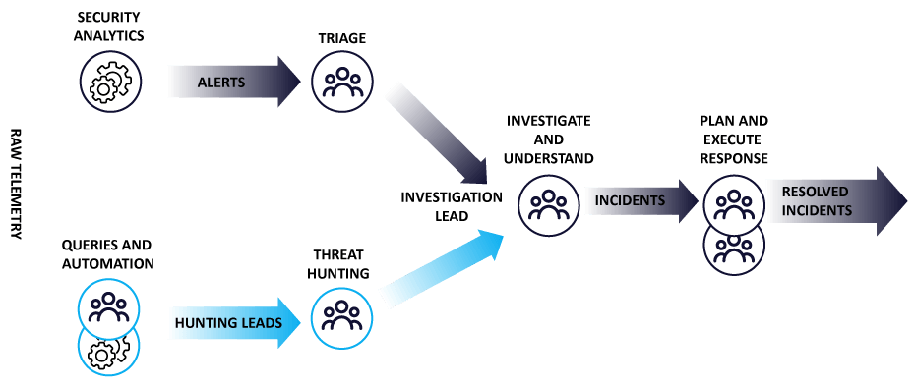
Cyber threat hunting
Methods, Tools, Techniques & Frameworks
What is Cyber Threat Hunting?
It is an active information security strategy used by a security analyst. Threat Hunting is a proactive method utilized by Security Analysts to identify unfamiliar or non-remediated cyber threats within an organization's network.
It involves iterative searches for indicators of compromise, including Advanced Persistent Threats (APTs) and Hacker tactics, techniques, and procedures (TTP) that can damage existing systems.

Slide 26
Cyber Threat Hunting Activities
1. Hunting for insider threats or outside threats or attackers:
  Cyber threat hunters can detect threats posed by insiders like employees and outsiders like criminal organizations.
2. Actively looking for known adversaries:
  A known attacker is someone whose code pattern is on the deny list of known dangerous programs or who is identified in threat intelligence services.
3. To find hidden risks and stop an assault from happening:
  Threat hunters constantly watch the computer environment and can identify irregularities that might point to a threat through behavioural analysis.
4. Predict & Update Response Plan:
  Threat hunters evaluate a threat as thoroughly as they can before implementing the incident response strategy to counter it. This is used to update the response plan and prevent any similar attacks.

Slide 27
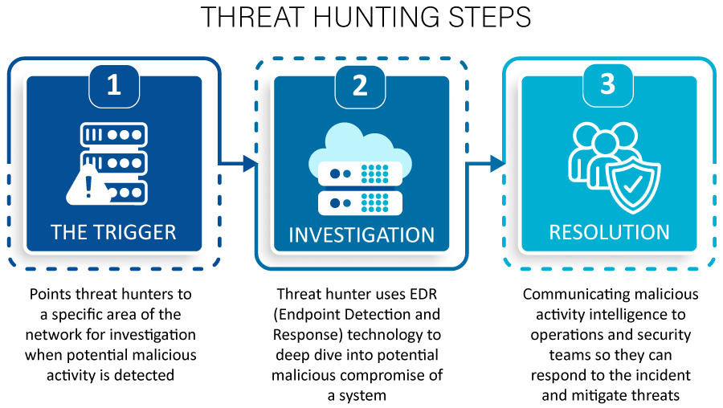
Effective Threat hunting process
Cyber threat hunters employ this structured approach to gather intelligence on attackers' strategies and objectives. Additionally, they utilize obtained insights to understand an organization's security landscape, anticipate future threats, and address existing vulnerabilities.
Effective Threat Search Process:
Trigger: Advanced detection systems identify anomalous behavior indicating potential threats, prompting threat hunters to investigate further.
  Example: Security teams anticipate future threats by exploring emerging technologies like fileless malware, triggering proactive hunting efforts.

Slide 28
Investigation: Threat hunters utilize Endpoint Detection and Response (EDR) technologies to analyze system vulnerabilities and potential intrusions.
  Example: Investigations continue until the threat is confirmed harmless or until comprehensive data about the malicious activity is collected.
Resolution: Operations and security teams leverage data on malicious activities to respond to incidents promptly and mitigates effectively.
  Example: Insights gained from both malicious and benign activities enhance the efficiency of automated systems, reducing reliance on human intervention.
Effective Threat hunting process

Slide 29
6. Threat Intelligence and Threat Hunting
6.4 Incorporating threat intelligence into incident response

Slide 30
Threat hunting methodologies and techniques:
1.Intelligence-based hunting:
Intel-based threat hunting is a reactive threat-hunting model using IoCs from intelligence sources. The hunt follows predestined rules set by the SIEM and threat intelligence. Intel-based hunts can use IoCs, hash values, IP addresses, domain names, networks, or host artifacts provided by intelligence-sharing platforms such as Computer Emergency Response Team – CERT. These platforms allow for the export of automated alerts in the form of Trusted Automated Exchange of Intelligence Information (TAXII) and Structured Threat Information Expression (STIX), which can then be imported into SIEM. Once the SIEM has issued the warning based on an IoC, the threat hunter can look into the harmful activity that occurred before and after the alert to discover any environmental breach.

Slide 31
2. Investigation using indicators of attack:
Investigation using Indicators of Attack (IOAs) is a proactive threat hunting method, aiming to detect APT groups and attacks through global detection playbooks. It's commonly utilized with threat frameworks like MITRE (Massachusetts Institute of Technology Research and Engineering".) ATT&CK (Adversarial Tactics, Techniques, and Common Knowledge).
The process involves:
  Utilizing TTPs(Tactics, Techniques and Procedures) and IOAs to pinpoint threat actors.
  Monitoring activities to identify patterns and isolate threats.
  Evaluating the environment, domain, and attack behaviors to build hypotheses aligned with MITRE.

Slide 32
Threat hunting methodologies and techniques:
3. Hypotheses-based hunting :
Hypothesis-based threat hunting is a proactive threat-hunting model that uses a threat-hunting library It’s aligned with the MITRE ATT&CK framework and uses the global detection playbooks to identify APT groups and malware attacks. Hypothesis-based hunts use IoAs and TTP of attackers.
Depending on the environment, domain, and threat behavior patterns utilized to form a hypothesis in line with the MITRE ATT&CK paradigm, the hunter determines the threat actors. Once the behaviour pattern is identified, the hunter monitors the activity patterns to detect, identify and isolate the threat.
As such, the hunter can proactively detect the threat actors before they can damage the environment.
  Analytics-driven: Hypotheses developed from structured frameworks and machine learning/AI data.
  Situational-awareness: Utilizes existing information and environment awareness to detect potential threats.
  Intelligence-driven: Hypotheses formed from threat actor tactics, techniques, and procedures (TTP). Testing involves observing system and network behaviors for TTP presence. Indicators of compromise (IoCs) or indicators of attack (IoAs) support intelligence-based hypotheses.

Slide 33
4. Hybrid Hunting :
Custom threat hunting is based on situational awareness and industry-based hunting methodologies. It detects anomalies in SIEM and EDR tools and may be tailored to meet the needs of the customer. They are proactively executed based on situations, such as geographical issues and targeted attacks. Both Intel and hypothesis-based hunting models employing IoA and IoC information can be used in these hunting operations.
  Customization: Security analysts combine various hunting methodologies, including industry-based, situational awareness, and specific requirements.
  Integration: Incorporates data from geopolitical situations to tailor the hunt accordingly.
  Automation: Due to vast data, machine learning techniques and threat intelligence are utilized to automate a significant portion of the process.

Slide 34
Threat Hunting Tools
To identify suspicious behaviors, Threat Hunters employ solutions and technologies. The following are the primary categories of threat hunting tools:
Network security monitoring tools: Antivirus, firewalls, and endpoint security solutions collect and monitor network security data.
SIEM solutions: Security information and event management (SIEM) solutions assist in handling raw security data and real-time threat analysis.
Analytics tools: Statistical and intelligence analysis software generates a visual report using interactive graphs and charts, making it easier to connect dots and spot patterns.

Slide 35
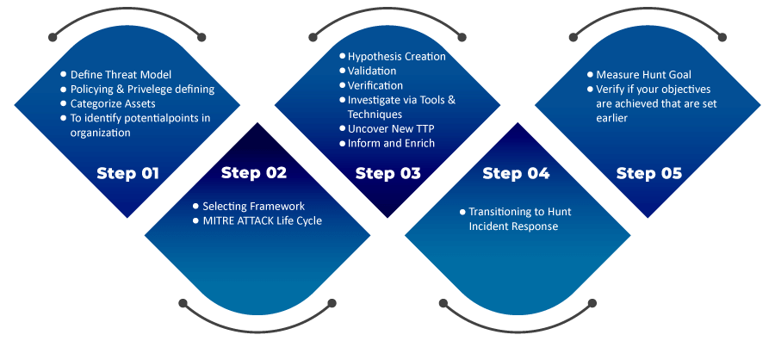
Threat Hunting Frameworks
There is a no. of threat-hunting frameworks which organizations can employ. Two of the most popular are:
  TaHiTI – Targeted Hunting integrating Threat Intelligence framework
    This framework is aligned with intel-based hunting. Threat intelligence, past occurrences, red teaming efforts, and other sources are sources of triggers.
  2. MITRE PRE-ATT&CK and ATT&CK frameworks
    These frameworks offer the expertise that may be used to address certain threat models and adversarial tactics.
An effective defence against threat actors is provided by a threat-hunting team's use of combinations of these techniques and resources as necessary.

Slide 36
Threat Hunting Process:
The actual threat hunt process starts from Step 3 in the given figure. Pre-hunt activities are integrated into our approach.
The threat-hunting is a cyclic process by nature. It consists of four processes.
  Creation of a hypothesis.
  Verifying and validating the hypothesis. This process also includes further investigation for any proof with the help of Tools and Techniques.
  Uncover new TTP and patterns.
  Inform and Enrichment. It is informing the incident response team about new TTP's which updates new threat definitions and categorizes threats using YARA and STIX.

Slide 37
What is Difference between Threat hunting vs Threat Intelligence?
Aspect | Threat Hunting | Threat Intelligence
Definition | Proactive approach to identifying and mitigating threats | Proactively collected, analyzed, and disseminated data on threats
Focus | Identifying and neutralizing active threats | Gathering information about potential and emerging threats
Methodology | Involves actively searching for signs of compromise | Involves collecting, analyzing, and interpreting data
Timeframe | Typically done in real-time or near-real-time | Ongoing process, with information collected over time
Output | Directly actionable insights and findings | Strategic reports, indicators of compromise, and advisories

Slide 38
Threat Hunting using Yara
https://www.geeksforgeeks.org/threat-hunting-using-yara/
https://support.phishingtackle.com/hc/en-gb/articles/4410170814609-YARA-Rule-Examples
Example 1 - Detect messages with a demand for money
Example 2 - Prevent specific website links or names
Example 3 - Hexadecimal strings for file signatures
Example 4 - Using Regular expression to detect URLs
Example 5 - Using multiple conditions to improve matches

Slide 39
Activity - ATT&CK Navigator
The ATT&CK Navigator is a web-based tool for annotating and exploring ATT&CK matrices. It can be used to visualize defensive coverage, red/blue team planning, the frequency of detected techniques, and more.
https://www.youtube.com/watch?v=78RIsFqo9pM
ATT&CK® Navigator (mitre-attack.github.io)
Example Flows — Attack Flow v2.1.7 documentation (center-for-threat-informed-defense.github.io)

